Slide 1
SDSC 2005 - Introduction to Computational Social Science (Lecture 3)
Hao PENG
(haopeng@cityu.edu.hk)
Department of Data Science
City University of Hong Kong
https://haoopeng.github.io/

Slide 2
Exploratory Data Analysis (EDA)
An initial examination of the data.
Examine each variable
Examine pair of variables to study their relationship
General EDA methods include two types.
numerical summary (“calculate numbers”)
graphical summary (“make plots”)

Slide 3

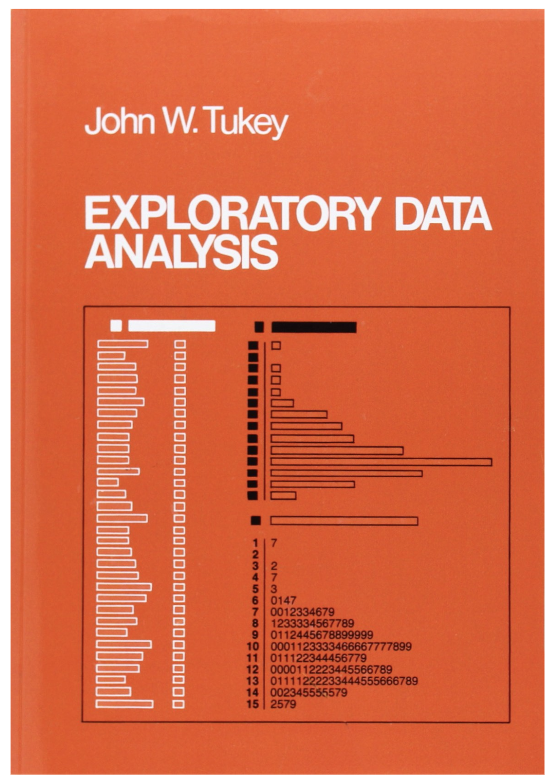
Birth of EDA
Originally developed by mathematician John Tukey in the 1970s, EDA techniques continue to be a widely used method in the data discovery process today.
Notes:
The eld of exploratory data analysis came of age when this book appeared in 1977.

Slide 4
Distribution
First few questions about examining one variable:
What are the possible values this variable takes?
What are the frequencies of those values?
Distribution:
Frequencies of all possible values of a variable.
How to describe and display the distribution of
a categorical variable?
a numerical variable?

Slide 5
Categorical variables
The values of a categorical variable are labels of categories.
Example: education levels of 38.4 million young adults from the 1999 Current Population Survey
Variable: education level
n = 38.4 million
Five labels: “Less than high school”, “High school graduate”, “Some college”, “Bachelor’s degree”, “Advanced degree”
The data is in the following format:
“Some college”, “Less than high school”, “High school graduate”, “High school graduate”, “High school graduate”, “Some college”, “Bachelor’s degree”, “Advanced degree”...

Slide 6
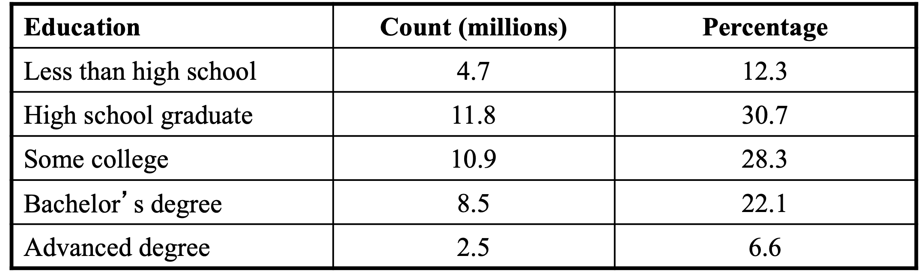
Numerical summary of a categorical variable
One can describe the distribution of a categorical variable by using the count or the percentage of individuals who fall in each category.
Example: a numerical summary of the education data
Question: do count and percentage convey the same information?

Slide 7
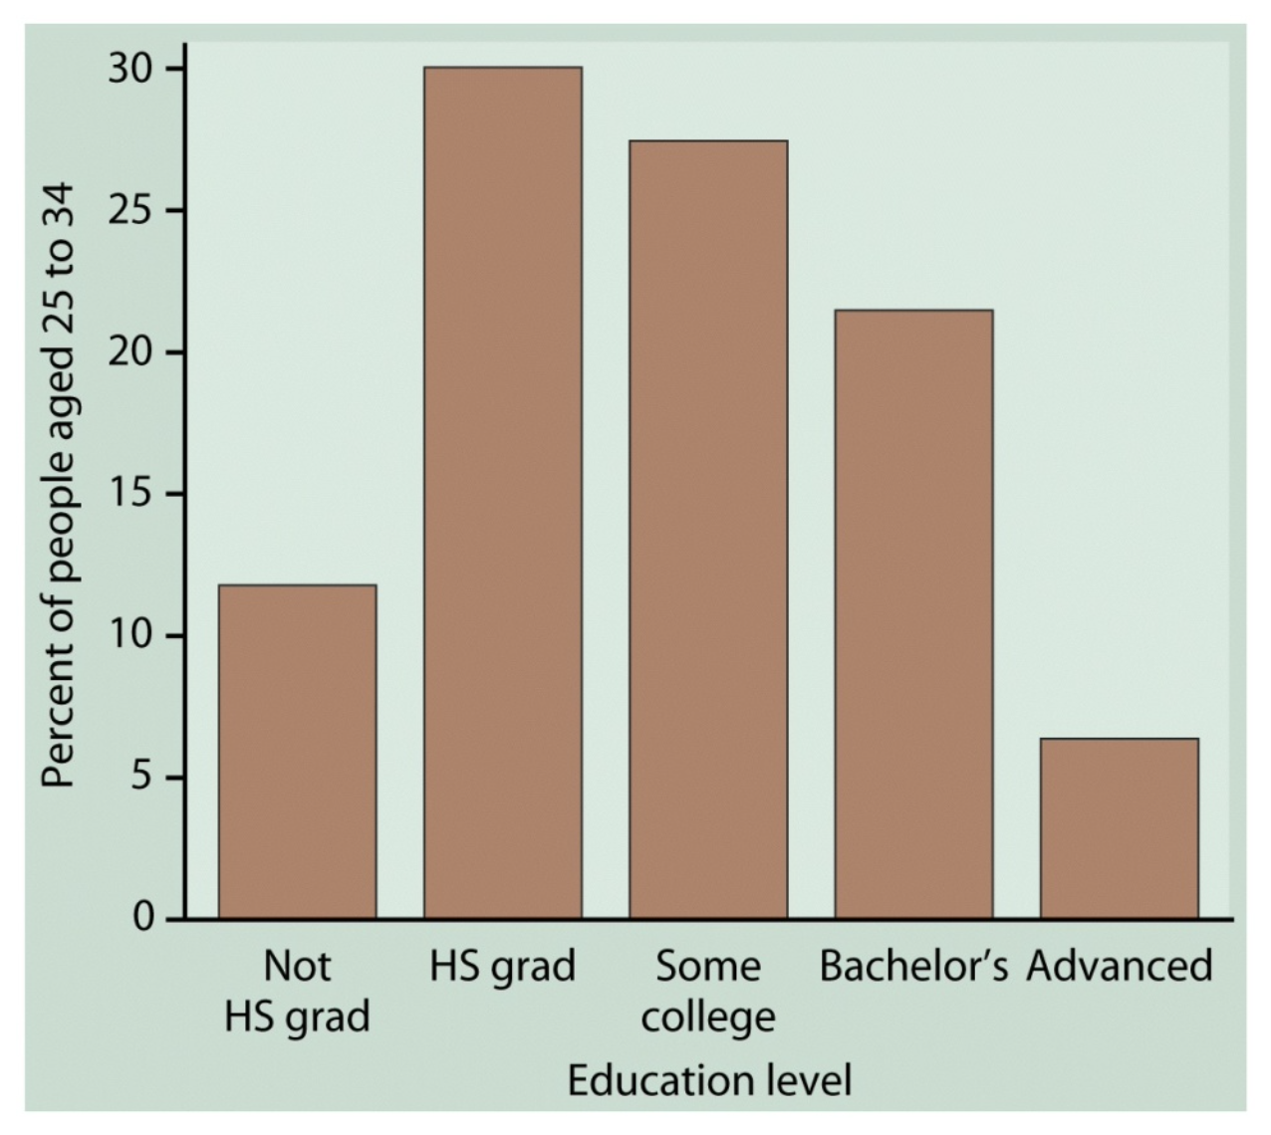
Graphical summary of a categorical variable
Bar chart: the height of each bar is proportional to the count (or percentage) of each category

Slide 8
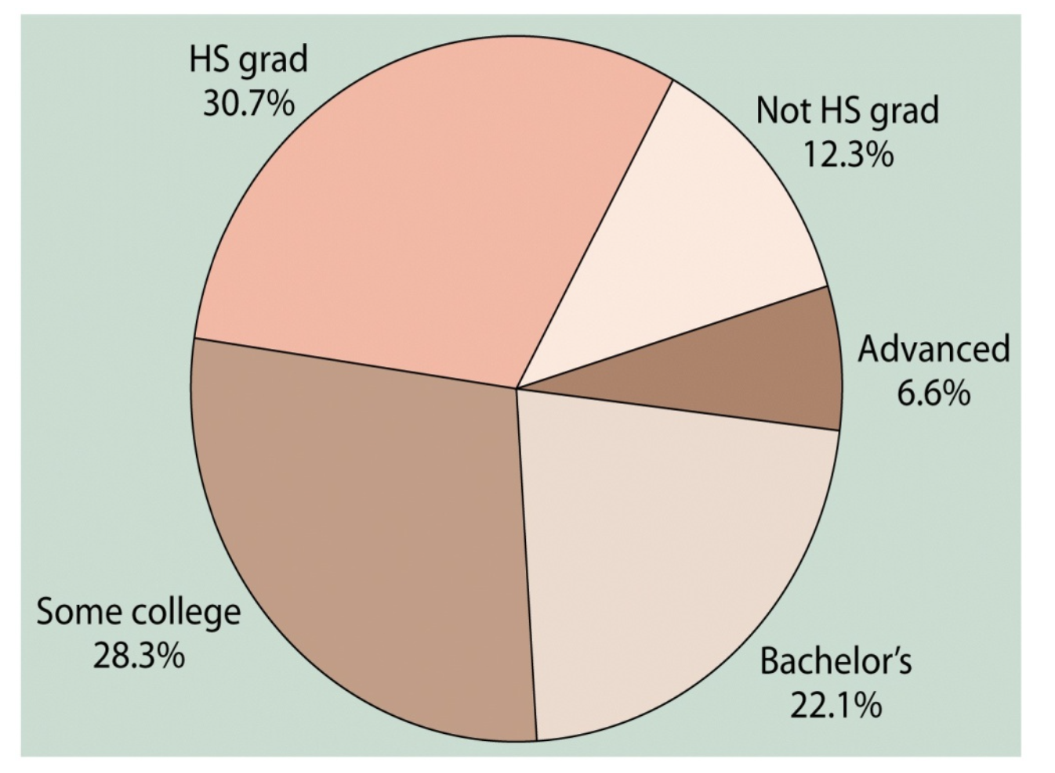
Graphical summary of a categorical variable
Pie chart: the area of each piece is proportional to the count (or percentage) of each category

Slide 9
Bar charts vs. Pie charts
Pie charts are less useful than bar charts if we want to compare actual counts: it is easier to compare bars than angles of wedges.
Pie charts are commonly chosen to illustrate market shares or sources of revenue for a company.

Slide 10
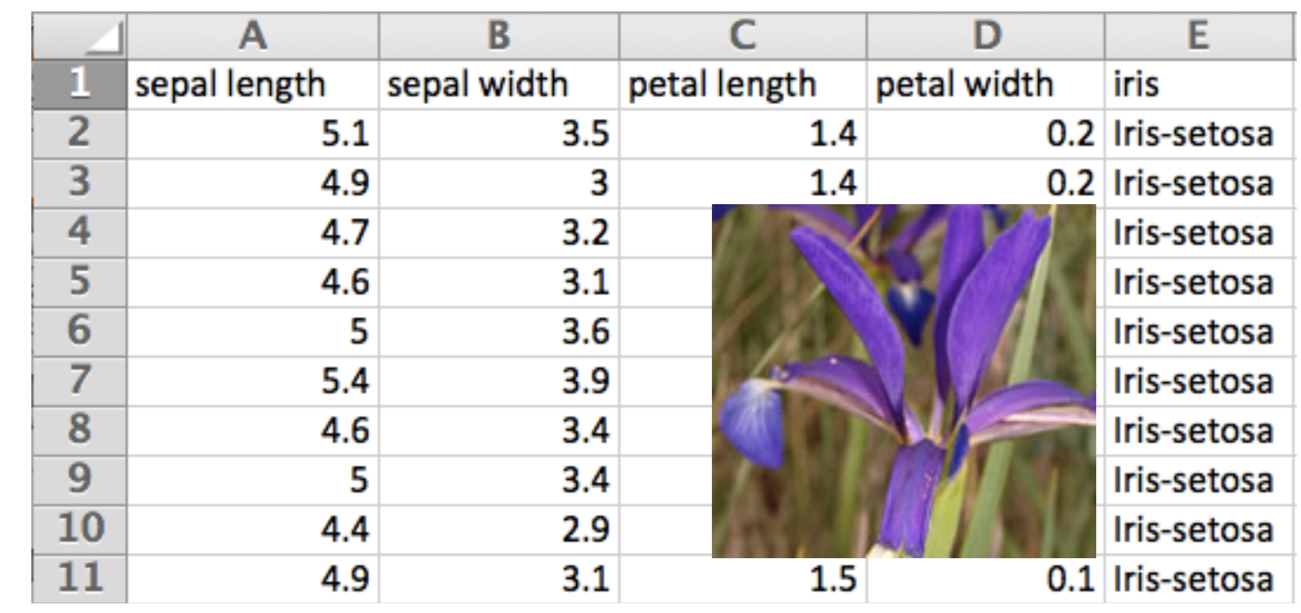
Numerical (Quantitative) variables
A numerical variable takes values in numbers which allow arithmetic operations.
• Example: the ”petal length" variable from the Iris data
(http://www.saedsayad.com/datasets/iris.txt)
• n = 150

Slide 11
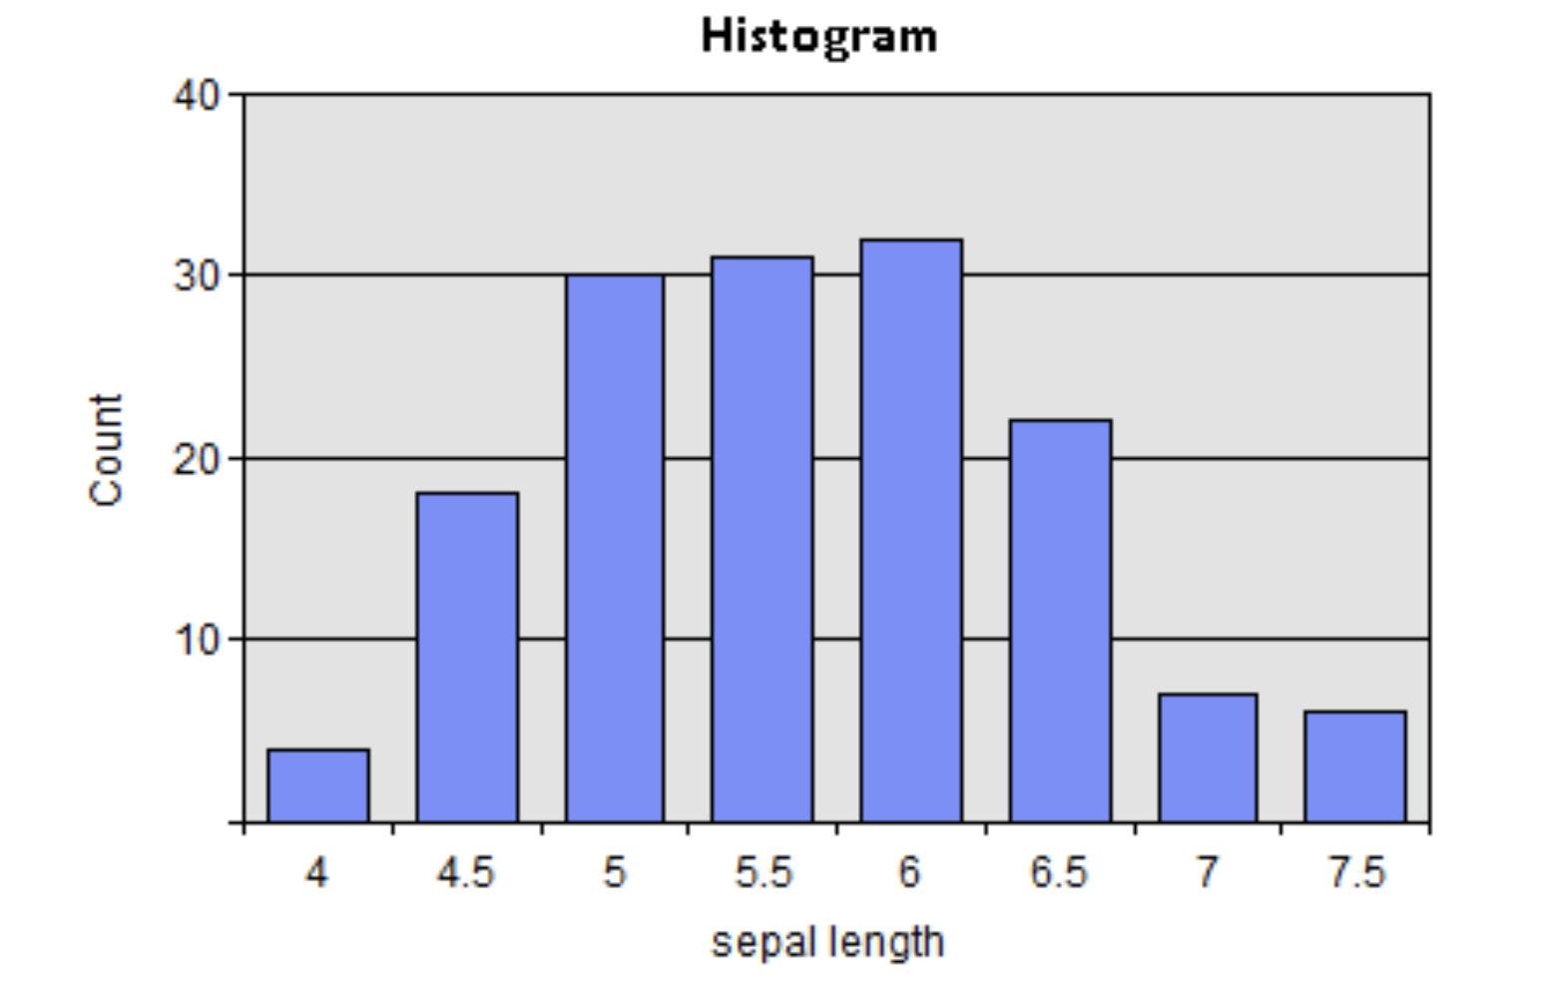
Graphical summary of a numerical variable
Histogram
To make a histogram:
Divide the range of possible values into equal intervals.
For each interval, draw a rectangle whose base is the interval and whose height is proportional to the number of observations falling into the interval.
Notes:
Draw a density see trend

Slide 12
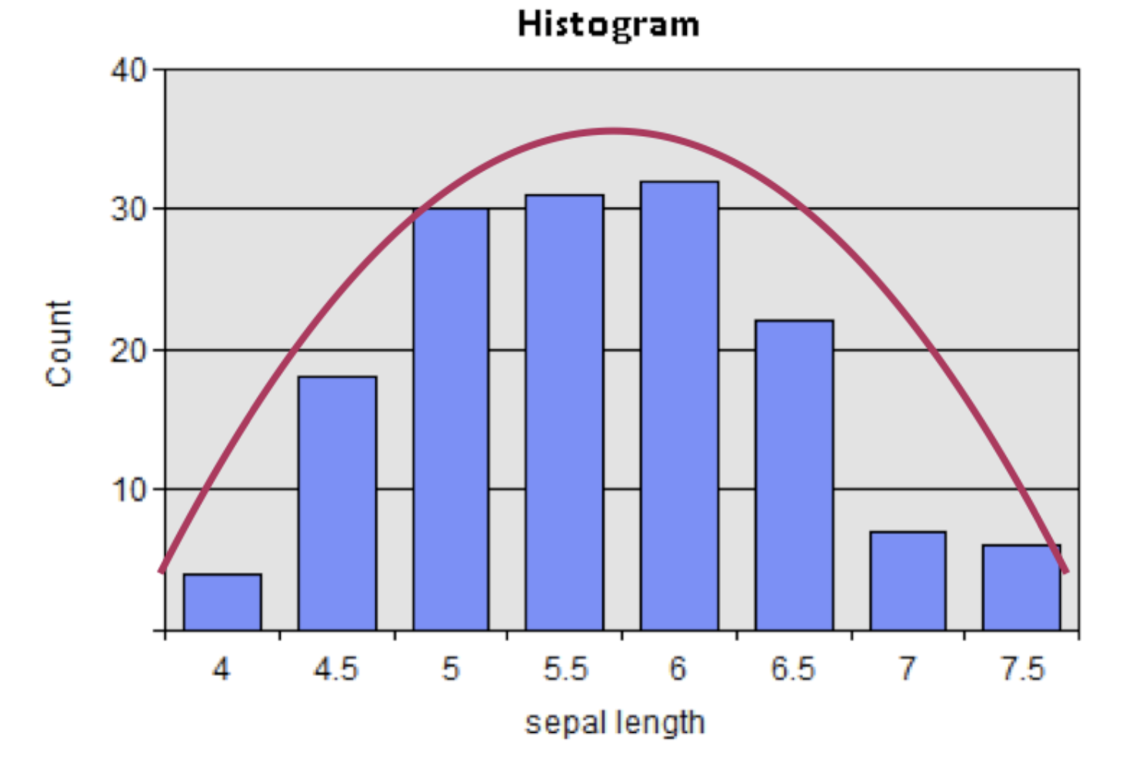
Graphical summary of a numerical variable
Many variables follow the normal distribution (bell shape), but many other don’t. Example?
Notes:
Draw a density see trend

Slide 13
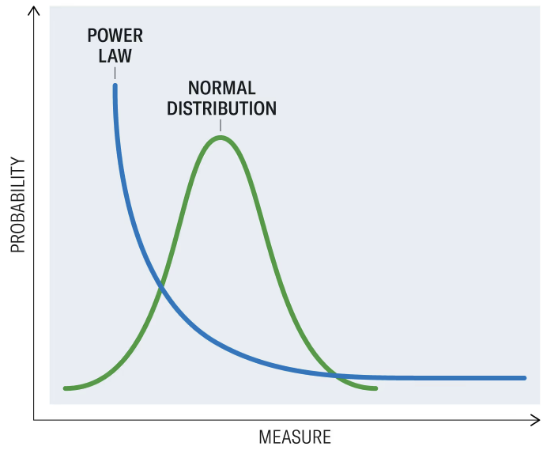
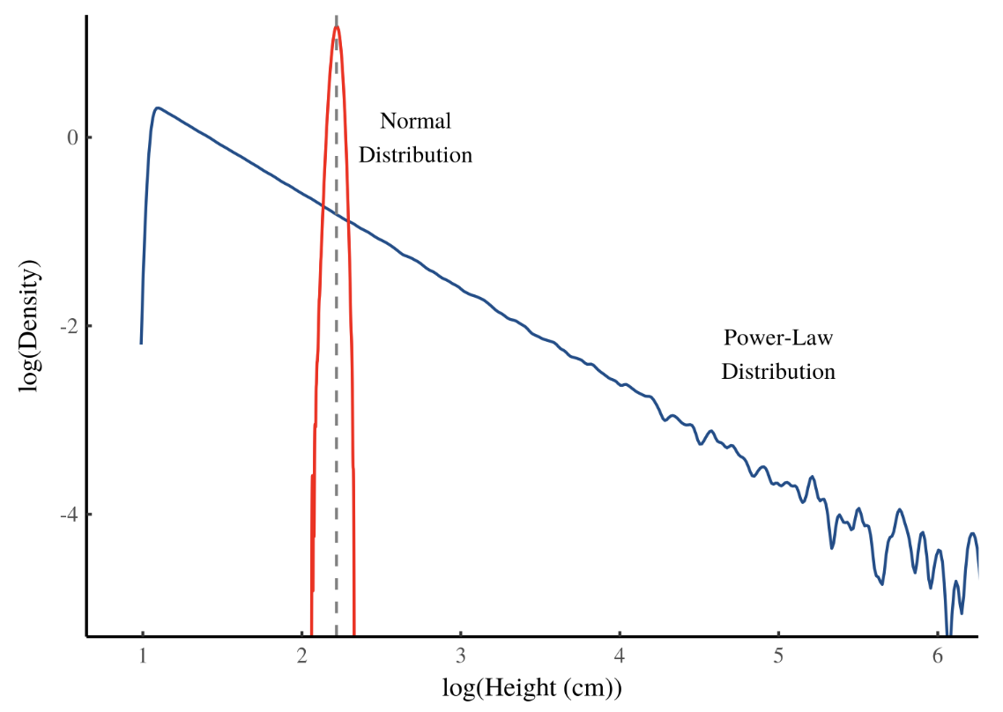
Power-law distribution
A statistical phenomenon where a small num. of items occupy a large fraction of outcomes (popularity, wealth, success, etc.).
It is perhaps the most well-know distribution in social & economic sciences.
Also known as the “80/20 rule”, “long-tail / scale-free distribution”:
log(Measure)
Super-stars in the right tail of the power-law are much more common than that observed in the “bell curve”.

Slide 14
Types of distributions
Unimodal: has one major peak
Bimodal: has two major peaks
Skewed to the right: when the right tail (larger values) is much longer than the left tail (smaller values)
Skewed to the left: the opposite of the previous

Slide 15
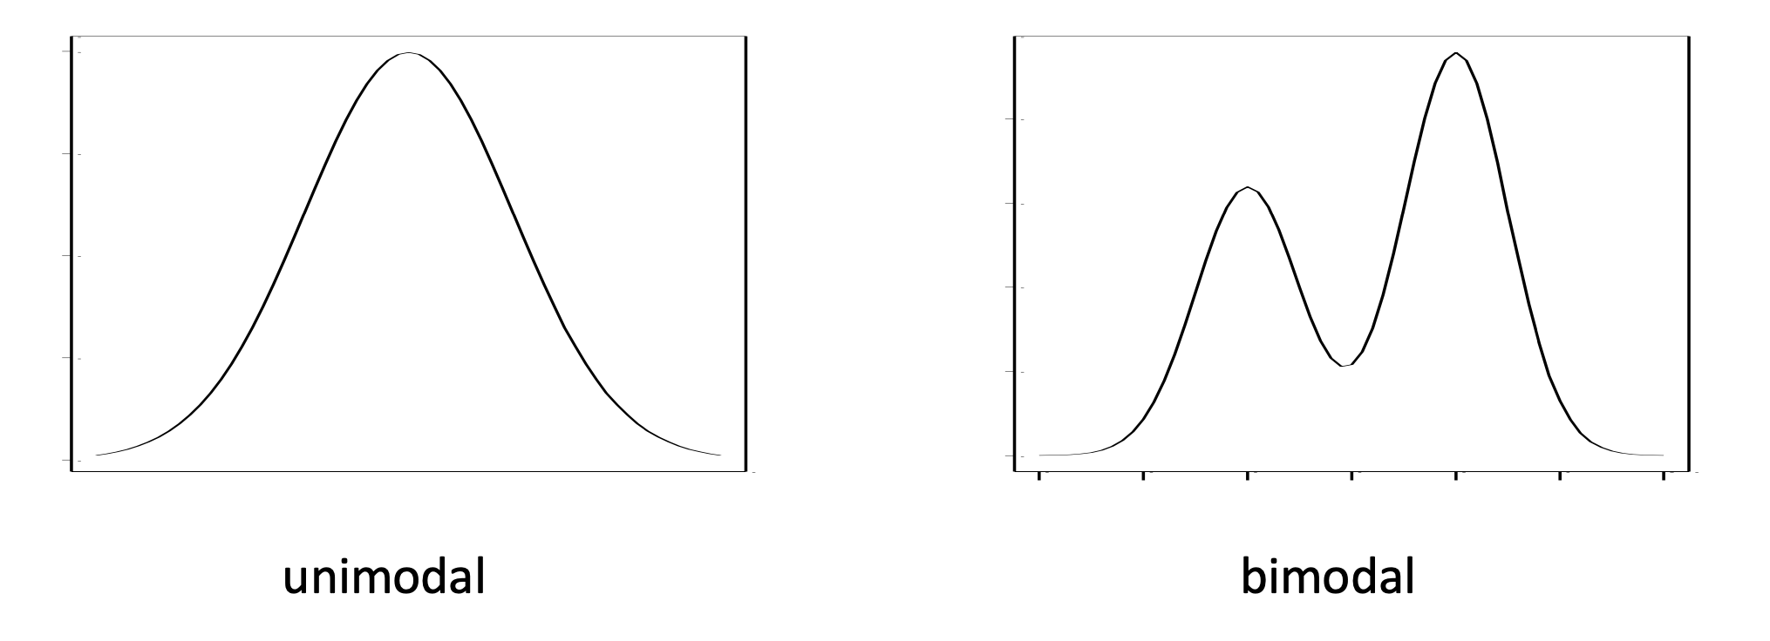
Shapes of a distribution

Slide 16
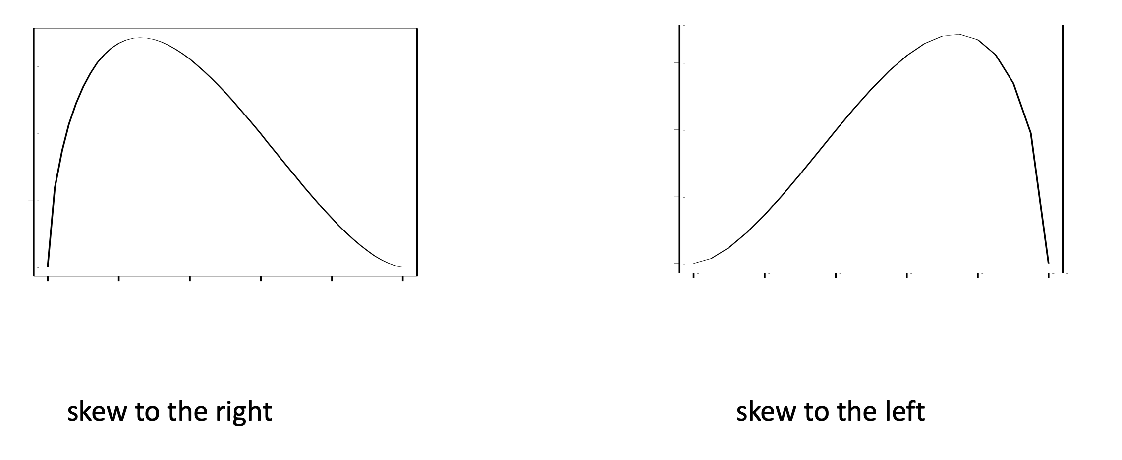
Shapes of a distribution

Slide 17
Numerical summary of a numerical variable
Different ways of finding the “center” of a distribution:
Mean = the average
Median = 50th percentile

Slide 18
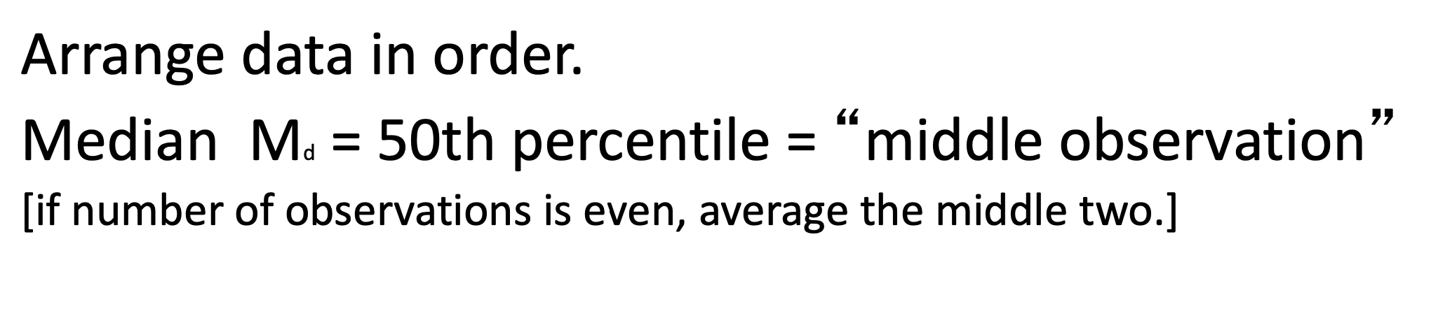
Median = 50th percentile
E.g., for data 1, 3, 3, 6, 8
M_{d} = 3
E.g., for data 1, 3, 3, 6, 8, 9 M_{d} = (3+6) / 2 = 4.5

Slide 19
“Robustness” of a statistic
Robust: insensitive to a few extreme observations (outliers)
Which is more robust: mean or median ?
Compare 1, 3, 3, 6, 8 to 1, 3, 3, 6, 8000000

Slide 20
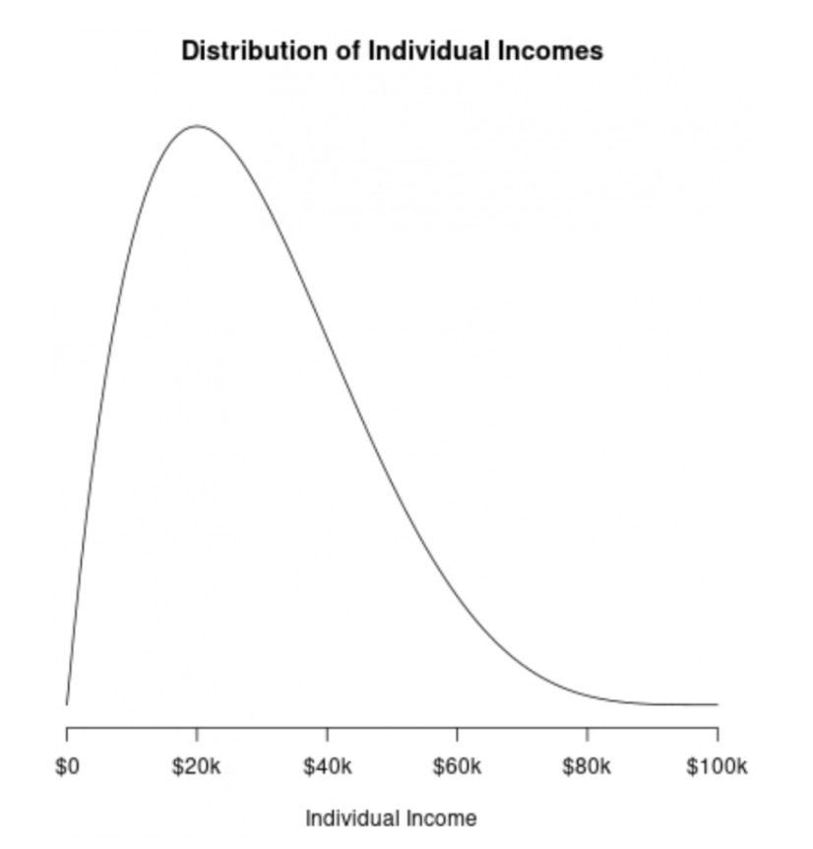
Which is which?

Slide 21
More about numerical summary: Mode
Categorical variable: mode is the category with the highest frequency of that variable
Numerical variable: mode is the location of a major peak of the variable’s distribution

Slide 22
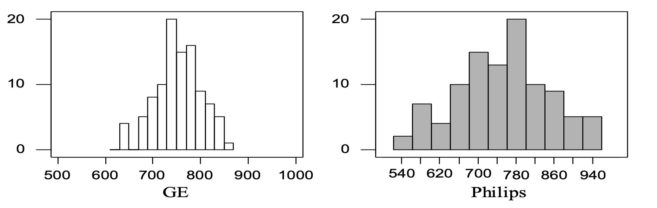
“Spread” of a numerical variable
Mean and median do not fully summarize a distribution.
Need to know degree of fluctuation!
“GE” and “Philips” Lightbulb Lifetimes (in hours)
“Philips” has more fluctuation although average is about the same.
“GE” exhibits better quality control: not much variation.
Some measure of data spread is needed.

Slide 23
Common measures of variability
Variance: The “average” of the squared deviations of all the measurements from the mean.
Standard Deviation: The square root of the variance. SD is the most common measure of spread or variability of a variable.
Variance = s², SD = s

Slide 24
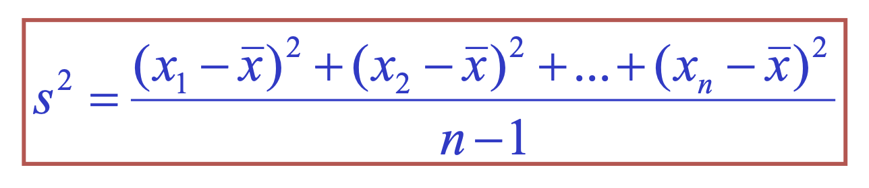
Interpretation of Variance and SD
How far are observations, on average, away from the mean?
Using deviations:
Variance:
“average” of the squared deviation

Slide 25
Other measures of spread
Range = max – min
• Median absolute deviation (MAD)
• Interquartile range (IQR)

Slide 26
Quartiles
Define first quartile (25th percentile) to be the median of the observations below the median
Define third quartile (75th percentile) to be the median of the observations above the median
1, 3, 3, 6, 8, 9
Q1 = 3
Q2 = 8
M_{d} = 4.5
The interquartile range (IQR) is Q3 - Q1 = 5

Slide 27
Example: customer satisfaction ratings
20 measurements on a 10-point scale:
9, 8, 3, 8, 10, 9, 8, 9, 5, 8, 1, 10, 8, 10, 7, 8, 9, 10, 5, 9

Slide 28
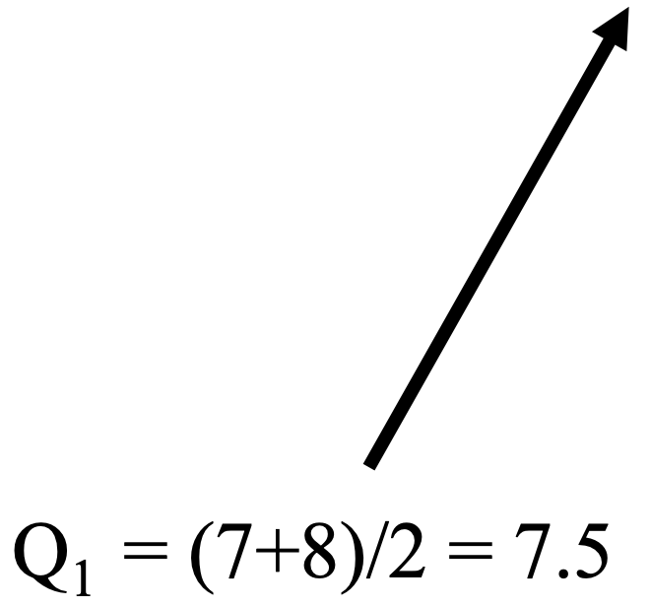
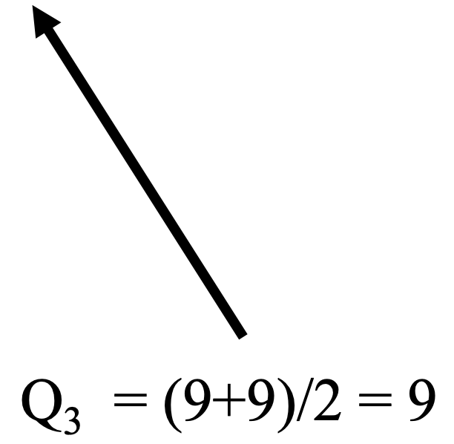
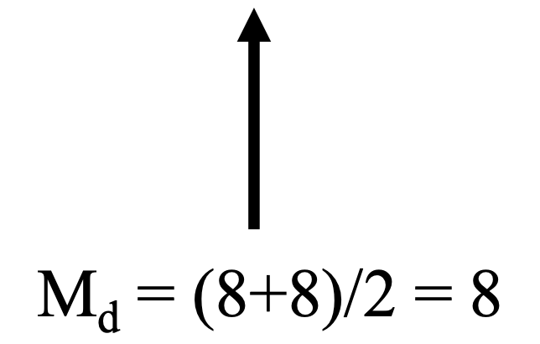
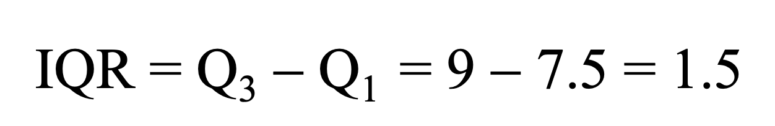
Example: customer satisfaction ratings
20 measurements on a 10-point scale:
9, 8, 3, 8, 10, 9, 8, 9, 5, 8, 1, 10, 8, 10, 7, 8, 9, 10, 5, 9
1 3 5 5 7 8 8 8 8 8 8 9 9 9 9 9 10 10 10 10

Slide 29
IQR and SD
IQR
Robust measure (same as the median)
Has the same units as the observations
SD
NOT a robust measure (same as the mean)
Has the same units as the observations
s=0 if and only if all observations are equal

Slide 30
How did John Tukey present a distribution?
Hinges and 5-number summaries
Example: 13 numbers:
2, 11, 13, 26, 1, 3, 11, 2, 1, 14, 16, 6, 8
Find quartiles, mean, max and min?

Slide 31
How did John Tukey present a distribution?
Hinges and 5-number summaries
Example: 13 ordered numbers:
1, 1, 2, 2, 3, 6, 8, 11, 11, 13, 14, 16, 26
Median: 8
First quartile: 2
Third quartile: 13.5
Minimum: 1
Maximum: 26
hinges

Slide 32
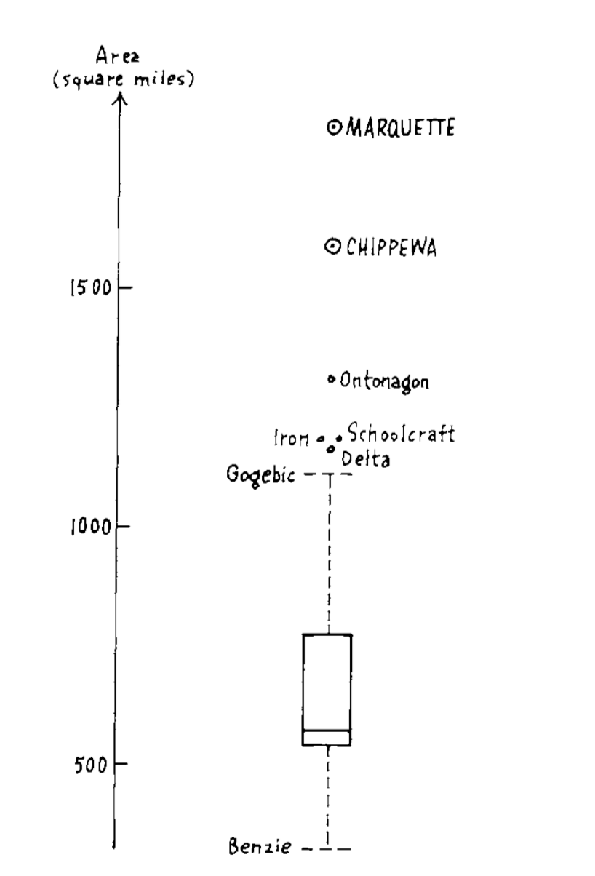
Box-and-whisker display (boxplot)
1. Box
Lower : First quartile (Q₁)
Middle: Median (M_{d})
Upper: Third quartile (Q₃)
2. Whisker
Lower: the larger value of
Q₁ – 1.5*IQR and minimum
Upper: the smaller value of
Q₃ + 1.5*IQR and maximum
3. Outliners: values outside whisker
outliers
whisker
box
whisker

Slide 33
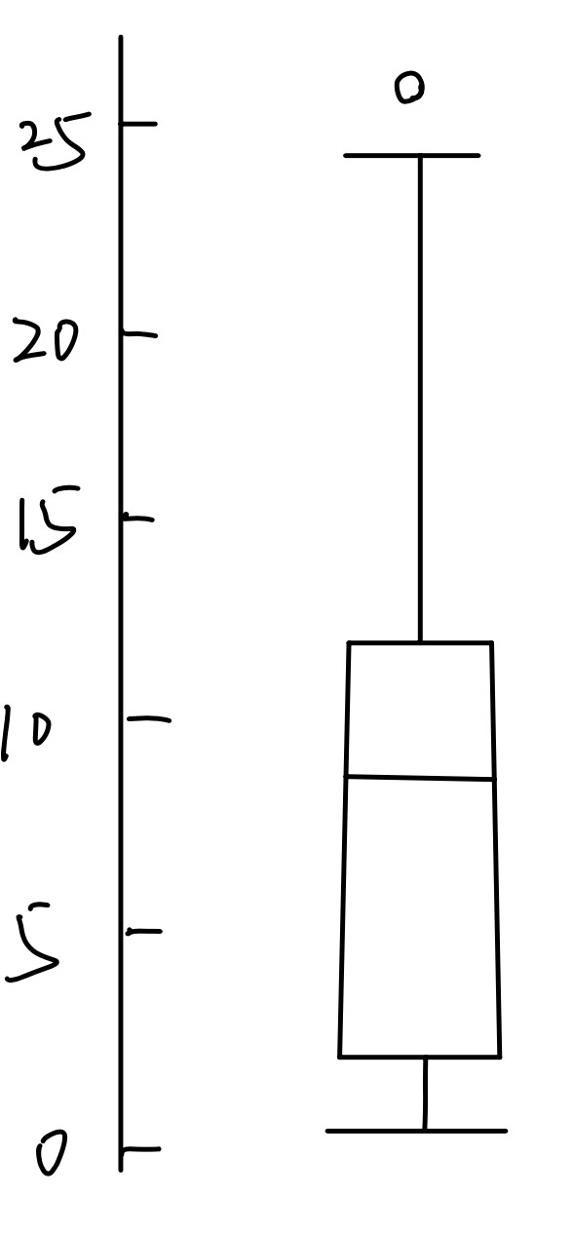
Box-and-whisker display (boxplot)
Our example: 1, 1, 2, 2, 3, 6, 8, 11, 11, 13, 14, 16, 26
Compute IQR = 13.5 – 2 = 11.5
Q3 + 1.5*IQR = 30.75 > max
Q1 – 1.5*IQR = -15.25 < min
We can get the following plot
max = 26
Q₃ = 13.5
M_{d} = 8
Q₁ = 2
min = 1

Slide 34
Choosing a summary
For a skewed distribution or a distribution with strong outliers the five number summary is usually better than mean and SD
Use SD for the spread when you use the mean for the center
Use IQR for the spread when you use median for the center
WARNING: Do not use only boxplots and numerical summaries to describe the shape of a distribution.
Add a histogram. Why?

Slide 35
Relationship betw. two variables
So far, we have focused on individual variables.
Now we will study relationship between two variables:
– Two categorical variables
– Two numerical variables

Slide 36
Two-way (contingency) tables
Contingency tables are used to describe the relationship between two categorical variables.
The table contains counts or percentages.

Slide 37
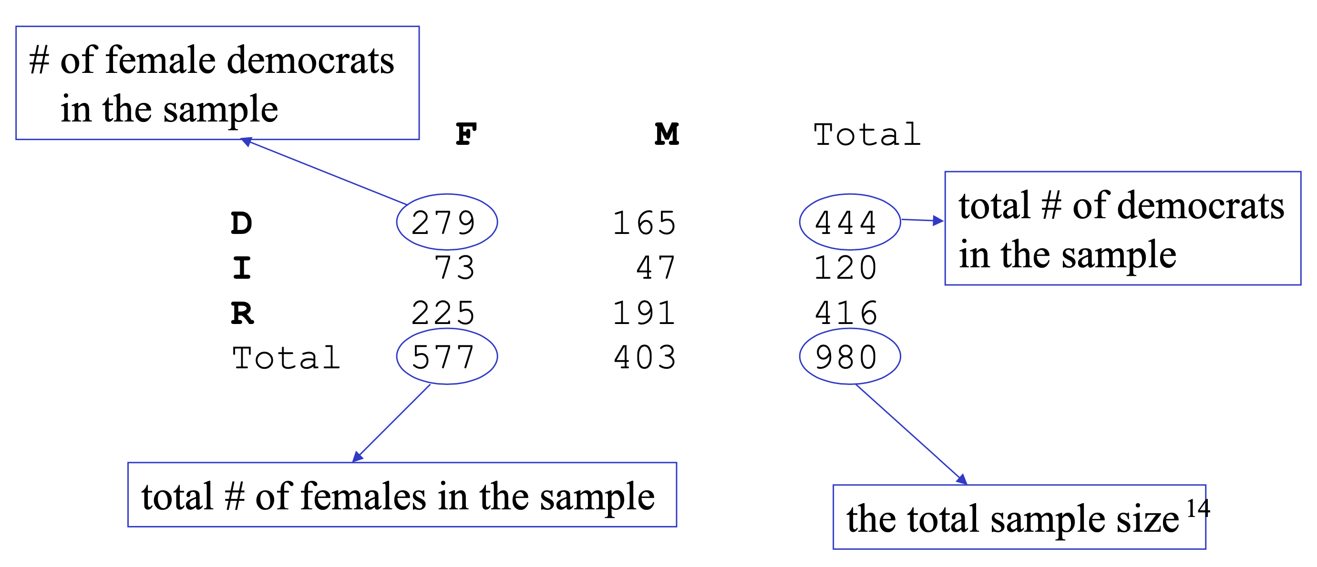
Two-way tables
E.g., Cross-classification of a sample of 980 individuals by gender and political party affiliation
Variables:
Rows: Party (D,I,R) | Columns: Gender (F,M)

Slide 38
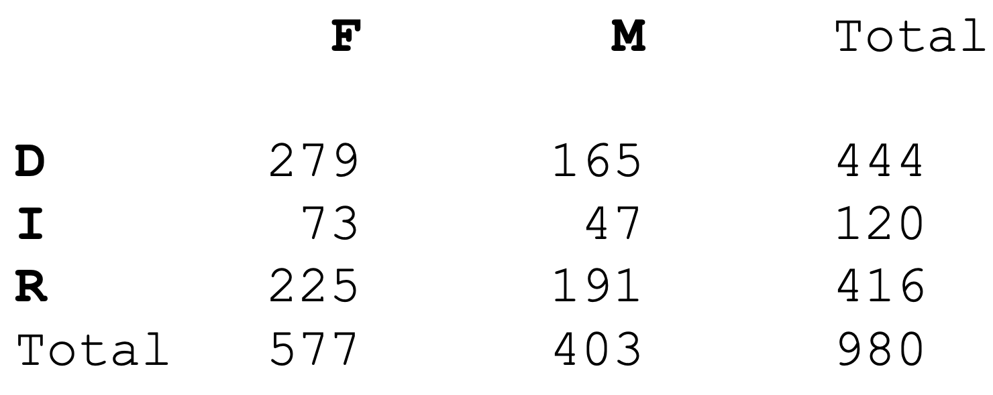
Notation
Party = row variable
Gender = column variable
Each combination of values of the two variables = cell

Slide 39
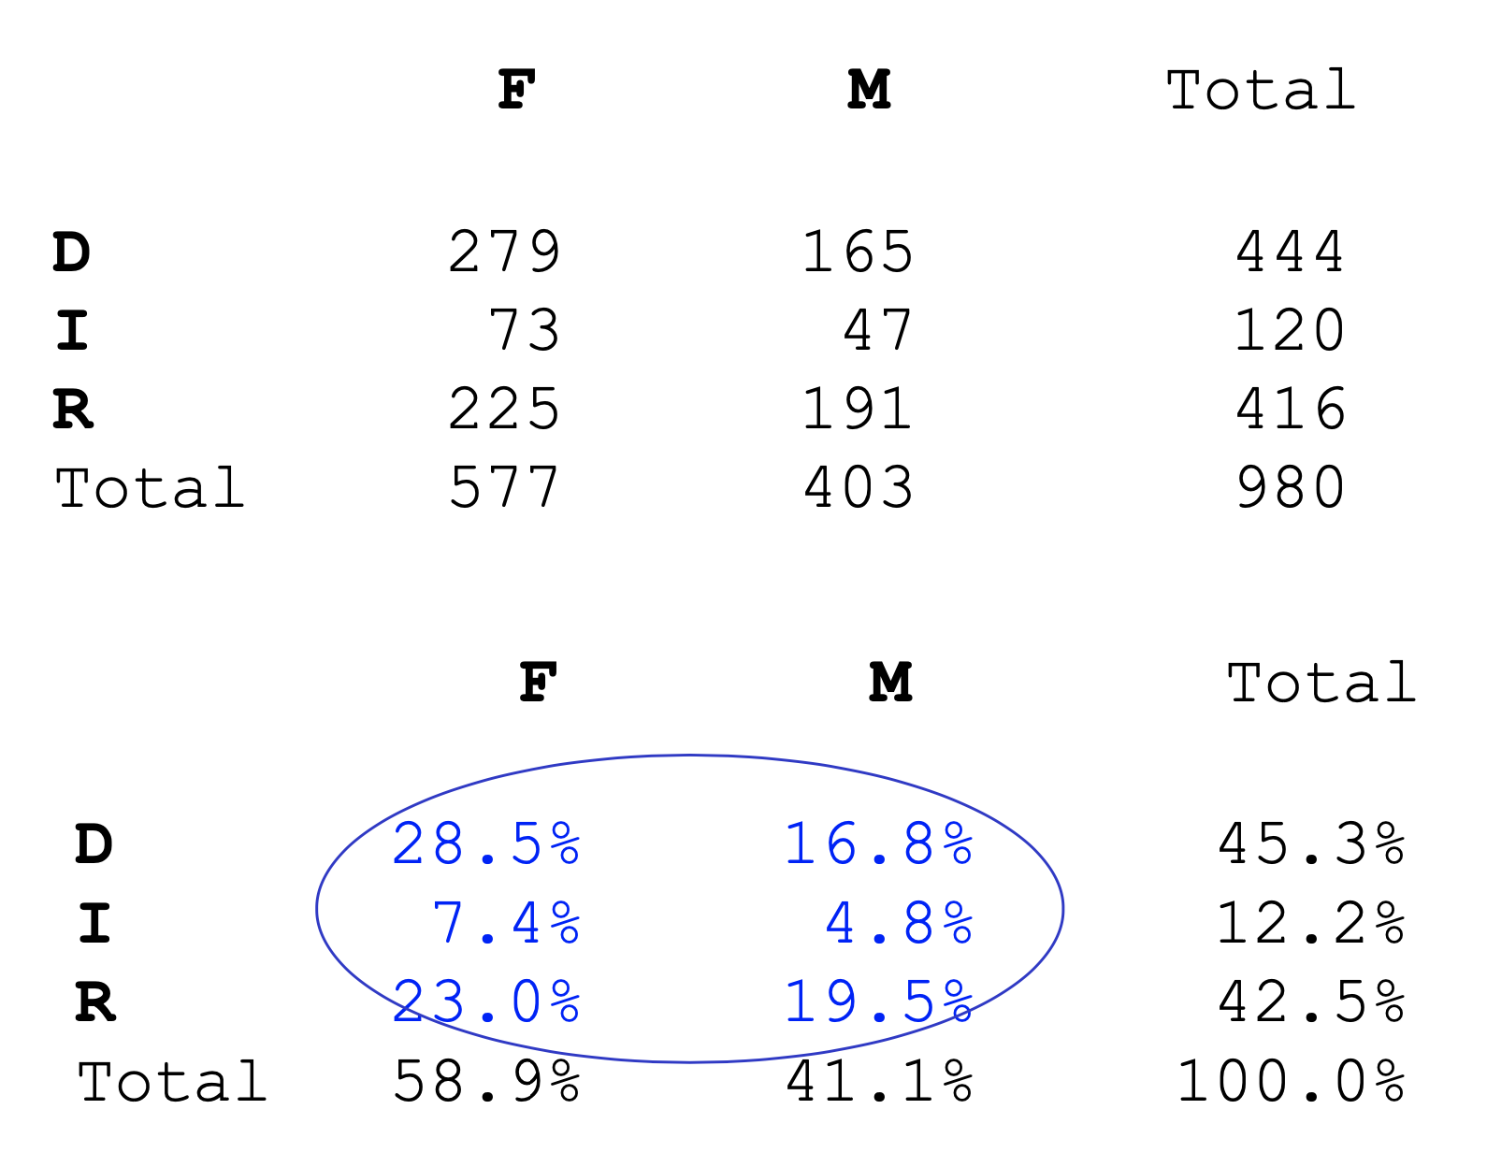
Joint distribution
A two-way table with proportions / percentages describing the joint distribution of two categorical variables.
Each cell gives the proportion of the total sample size.

Slide 40
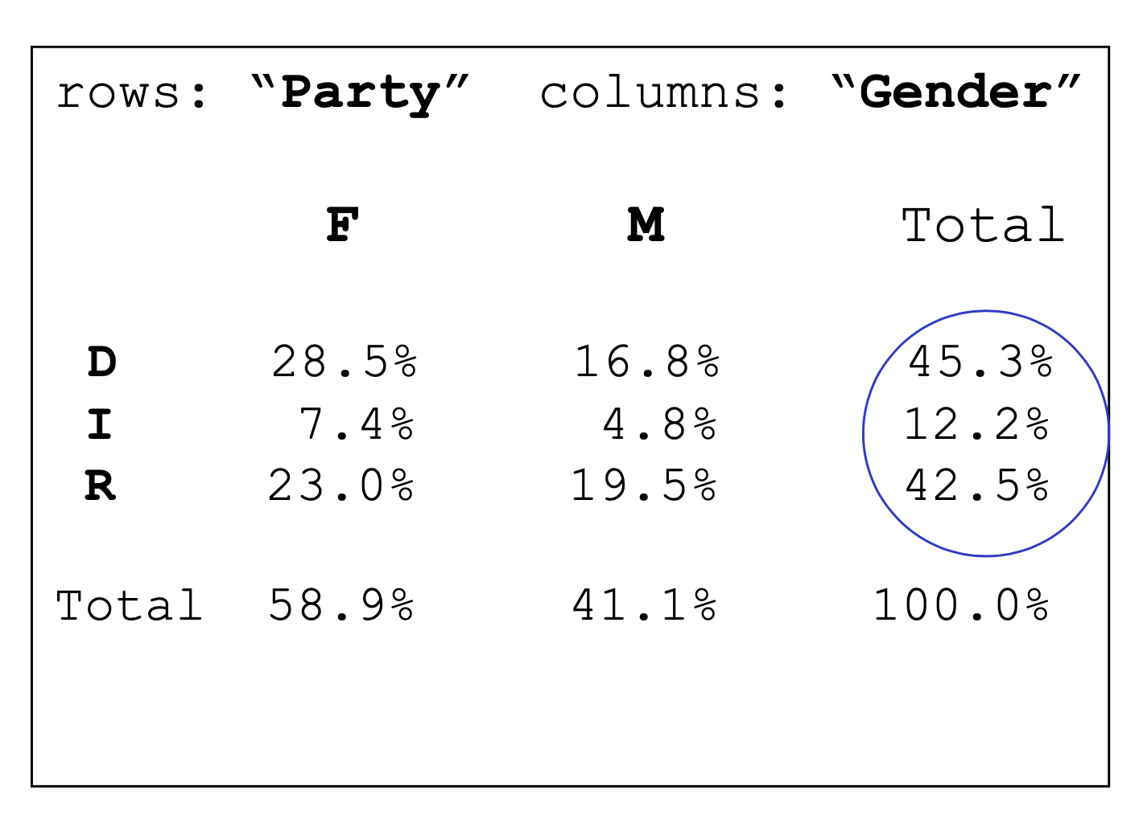
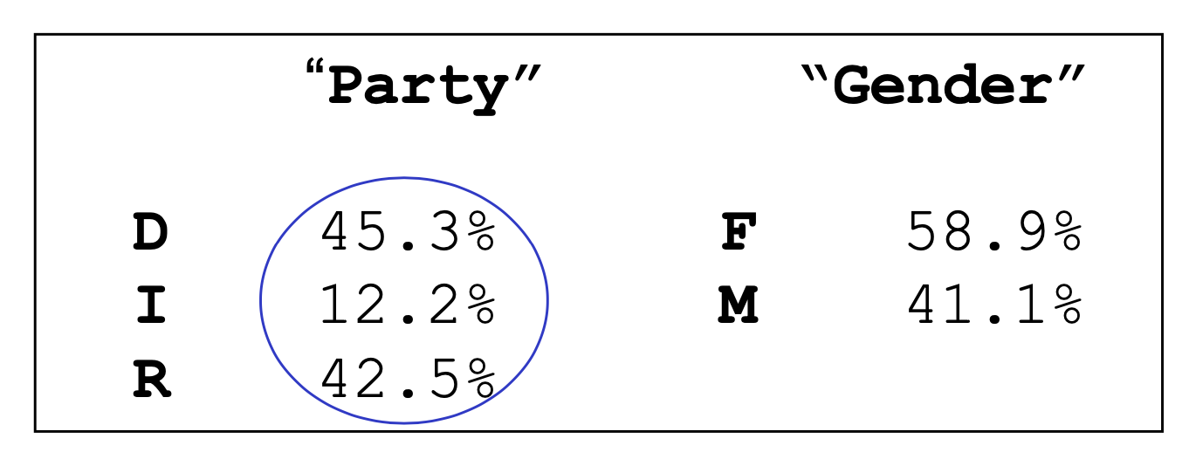
Marginal distribution
Marginal distribution: distribution of a single variable

Slide 41
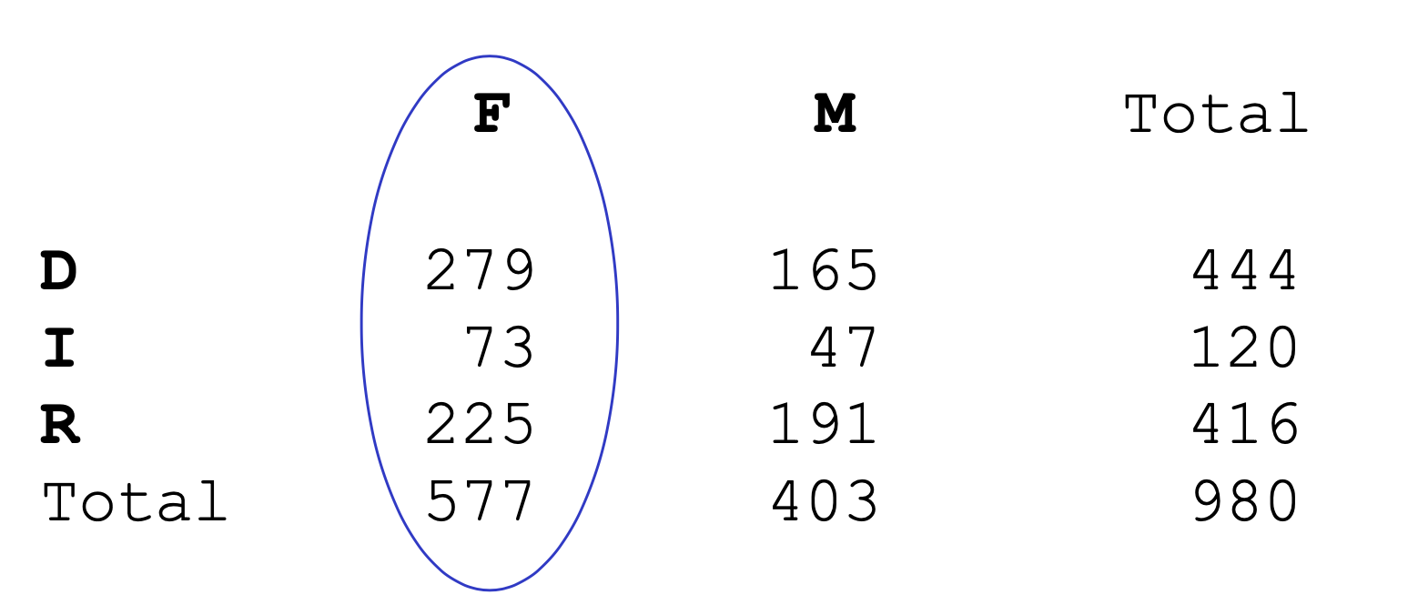
Conditional distribution
Conditional distribution: distribution of one variable after we restrict attention to (condition on) values of the other variable
E.g., What is the distribution (in our sample of 980 ) of party affiliation conditional on Gender = F?

Slide 42
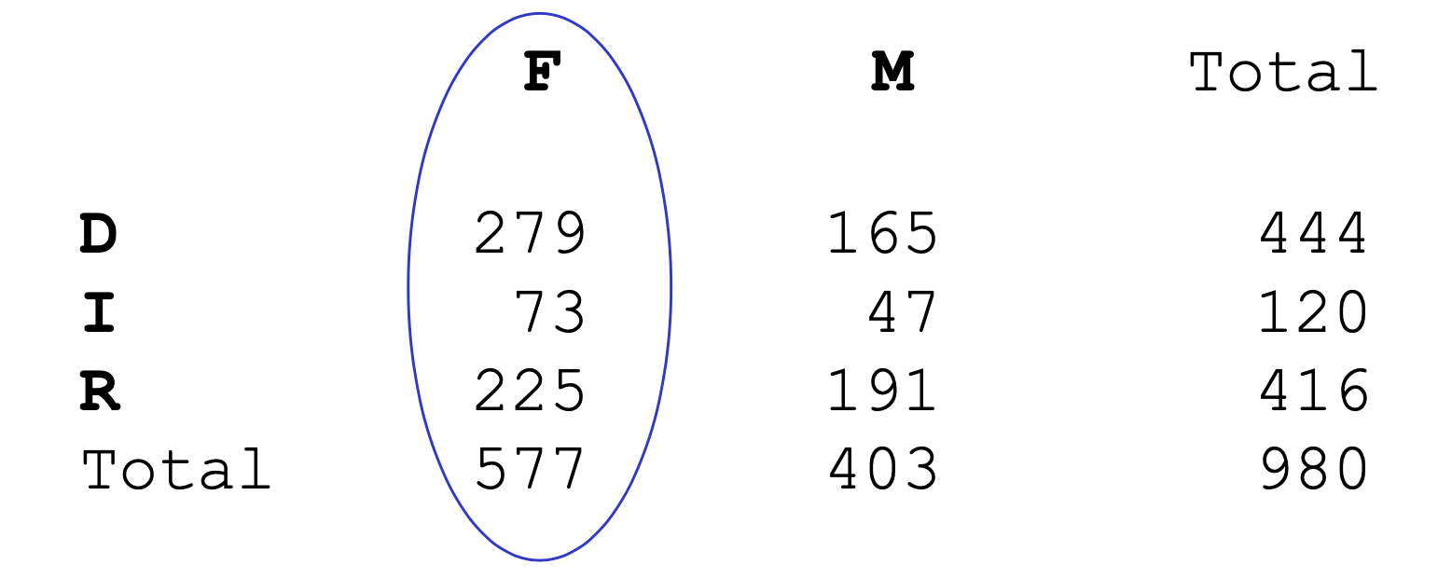
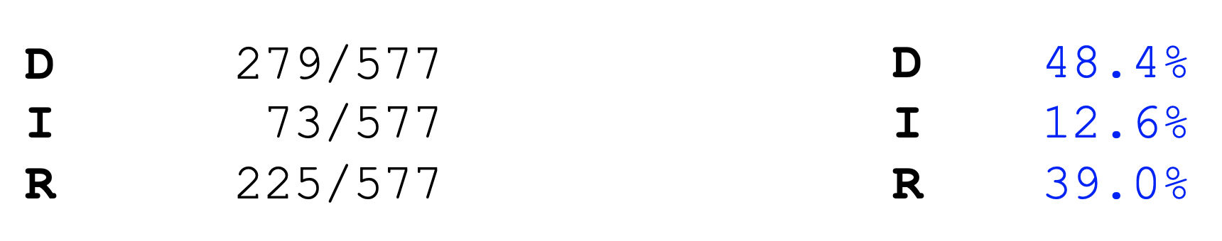
Conditional distribution
What is the distribution (in our sample of 980 ) of party affiliation conditional on Gender = F?

Slide 43
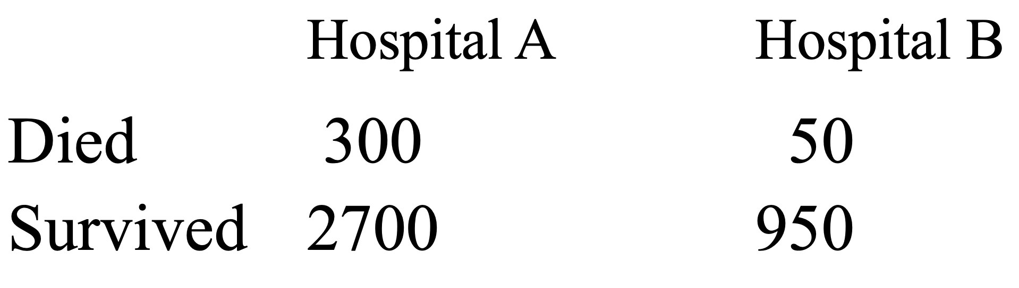
Another example
Two-way table:
Death rate (conditional on hospitals):
Hospital A: 300/3000=10%
Hospital B: 50/1000 = 5%

Slide 44
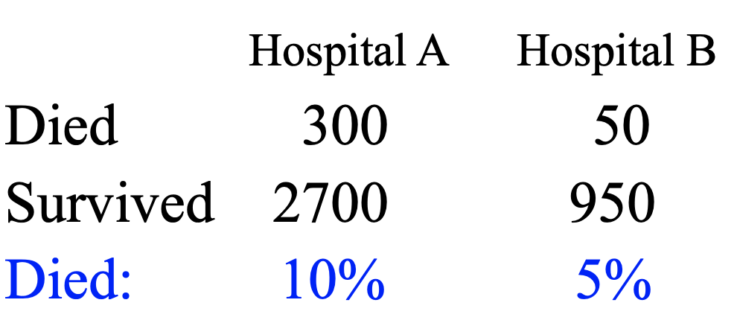
Simpson’s paradox
Association between two variables has a direction different from the association conditional on a third variable (lurking variable, hidden variable, or confounding variable).
What could be a confounding variable in this example?

Slide 45
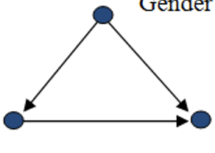
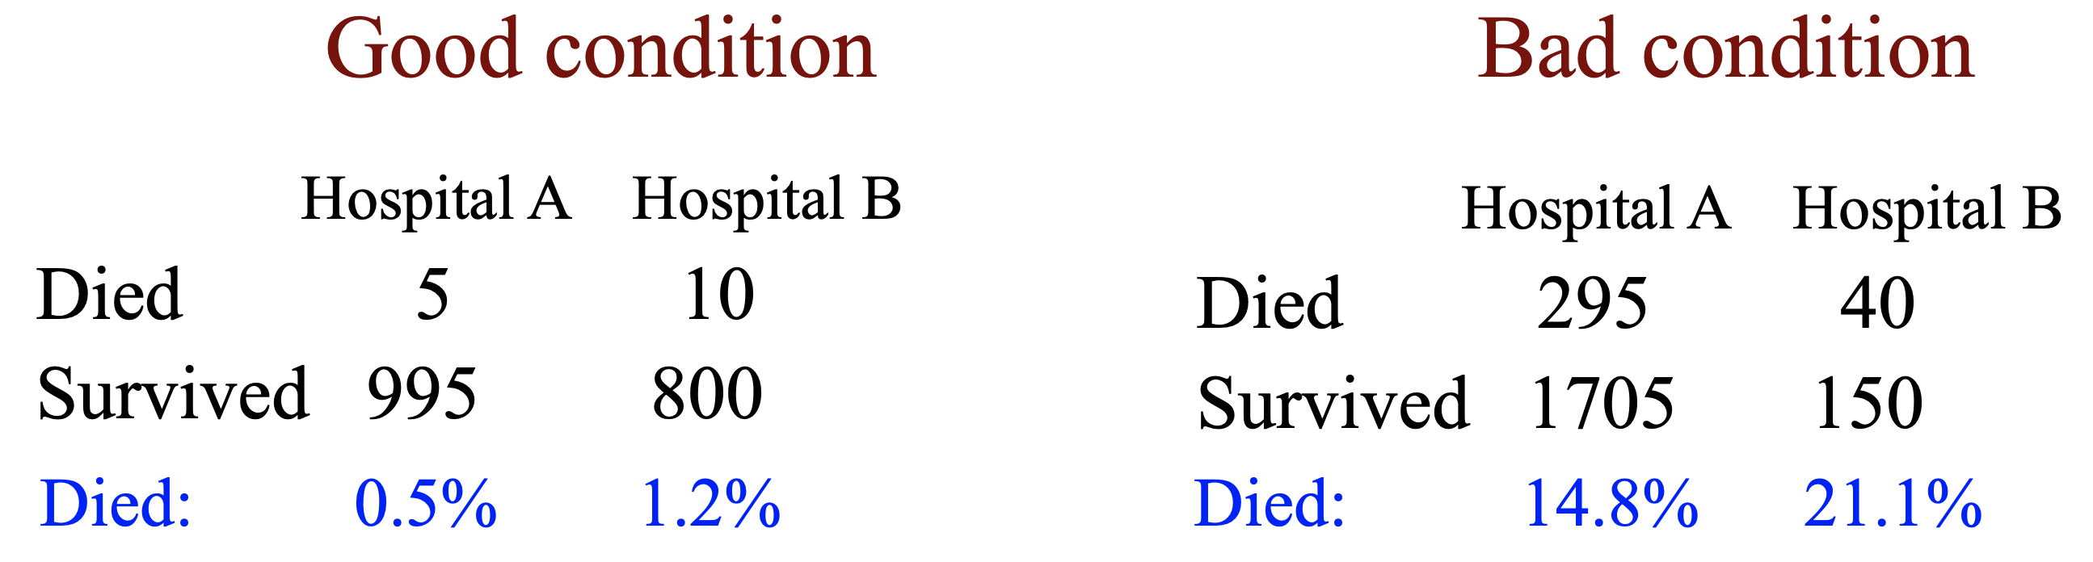
Simpson’s paradox
Disease condition is a confound when studying death rate
Disease condition
Hospital selection
Death status

Slide 46
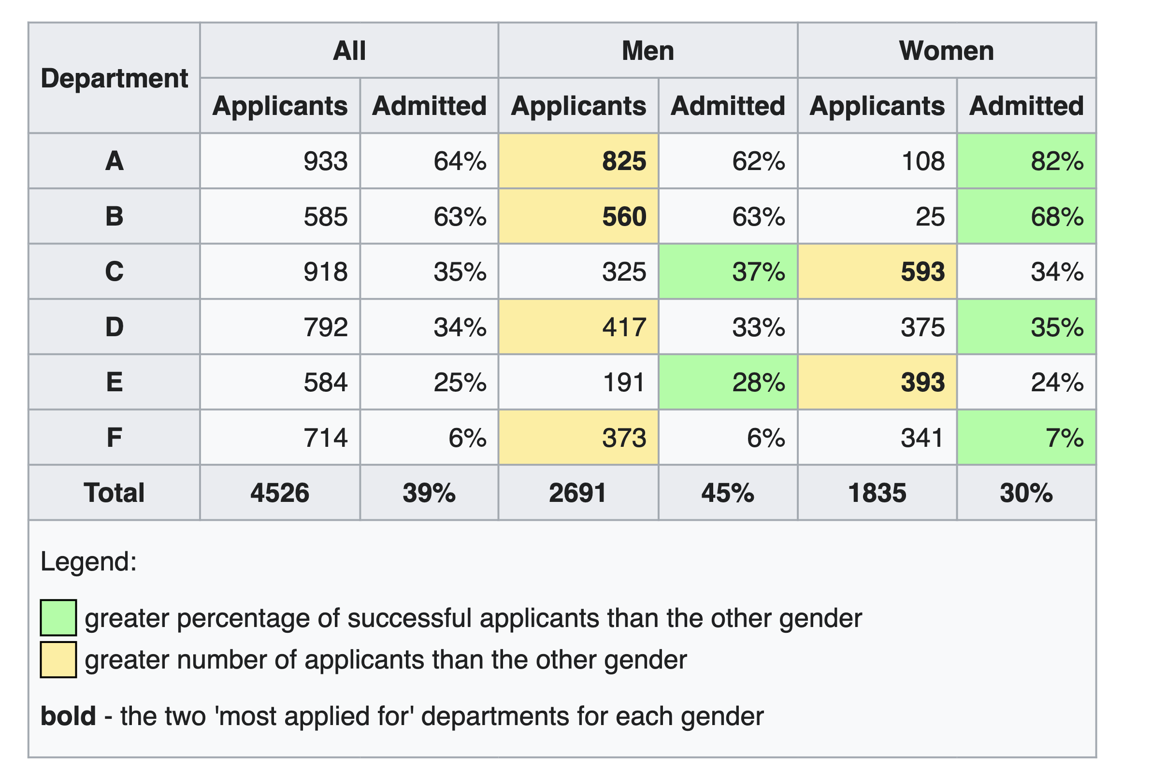
Simpson’s paradox
A change in the direction of association between two variables when data are separated into groups defined by a third variable.
Berkeley Graduate Admission Sex discrimination case (1977): https://homepage.stat.uiowa.edu/~mbognar/1030/Bickel-Berkeley.pdf

Slide 47
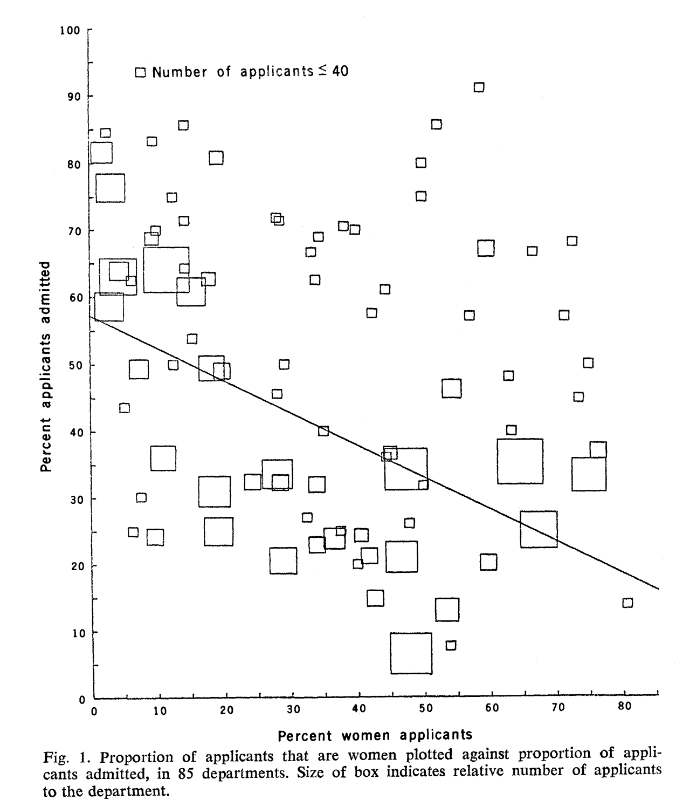
Simpson’s paradox
Female students more often apply for programs with lower acceptance rate.
Thus,
Gender gap in the overall acceptance is explained by the gender difference in academic areas.

Slide 48
Scatter plot (two num. var.)
Shows the relationship between two numerical variables measured on the same individuals;
Each observation appears as a datapoint in the plot (X vs. Y);
Useful for:
Look for overall pattern and deviations from that pattern; Outliers are individual values that fall outside the overall pattern of the relationship.
Describe the overall trend by form, direction, and strength.

Slide 49
Scatter plot (two num. var.)
Example:
Five students’ performance in class
X = attendance score
Y = final exam score
40
30
20
10
0
5
5
3
3
4
4
Y
1
 | 1 | 2 | 3 | 4 | 5
X | 7 | 19 | 23 | 29 | 33
Y | 14 | 16 | 28 | 27 | 35
2
2
1
1
2
3
4
5
0 10 20 30 40
X
Note: to add a third variable to the scatterplot, you can use different colors (intensity) or symbols to represent that variable.

Slide 50
Scatter plot
Form: clusters, linear, curvy association, etc.
Direction (trend): positive association, negative association.
Strength: how close do the data points follow the direction.
Positive association: above-average values of one variable accompany above-average values of the other, and below-average values also tend to occur together.
Negative association: above-average values of one variable accompany below-average values of the other and vice versa.

Slide 51
Types of relationships (association)
Linear relationships
Curvilinear relationships
Y
Y
X
X
Y
Y
X
X

Slide 52
Strength of relationships
Strong relationships
Weak relationships
Y
Y
X
X
Y
Y
X
X
Linear relationship can be described by Pearson correlation coefficient
Notes:
A linear relation is strong if the points lie close to a straight line, and weak
if they are widely scattered about a line.

Slide 53
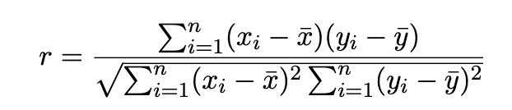
Pearson correlation (r)
Measures the direction and strength of the linear relationship between two numerical variables.
It has a value between –1 and 1.
The correlation strength increases as r moves away from 0 to either –1 or 1 (the absolute value).
Don’t confuse r with the slope of the straight line fit!

Slide 54
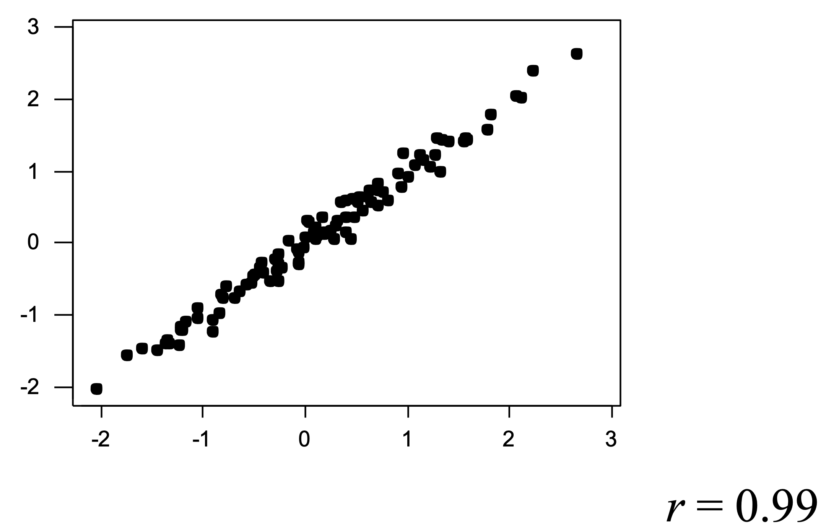
Strong correlation

Slide 55
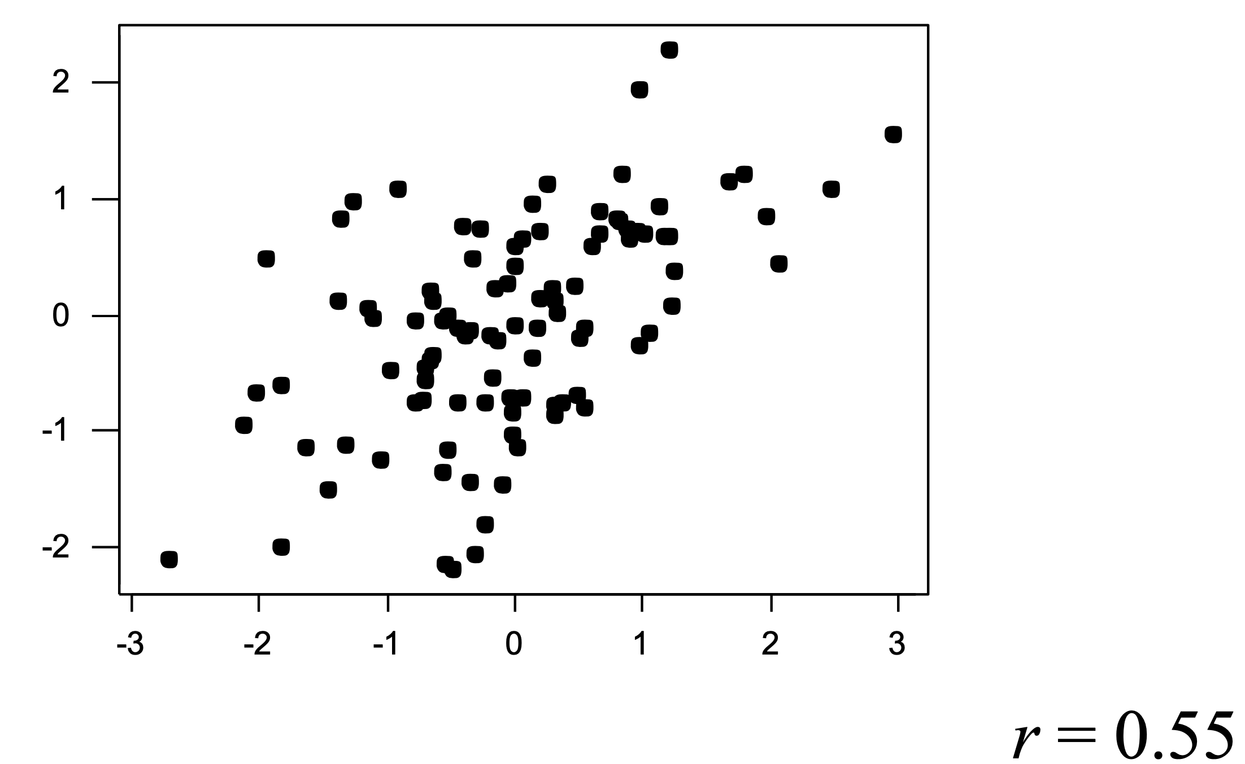
Moderate correlation

Slide 56
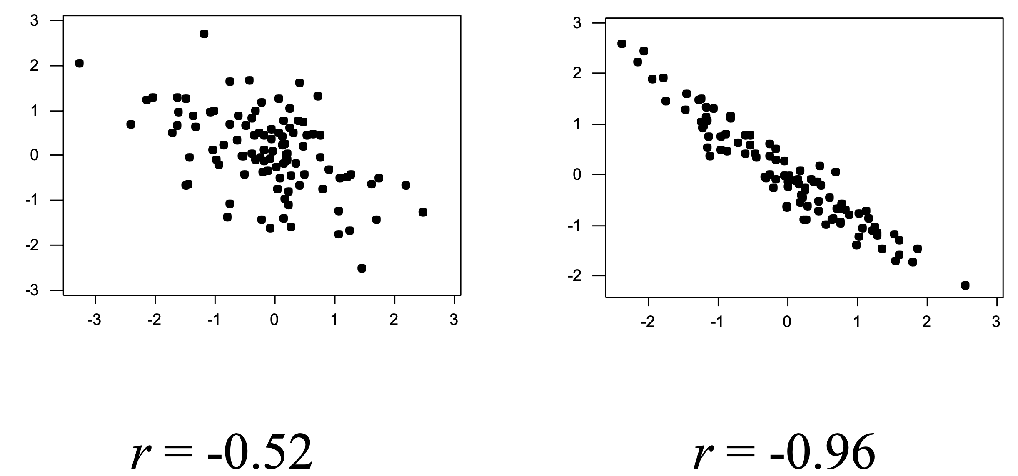
Negative correlation

Slide 57
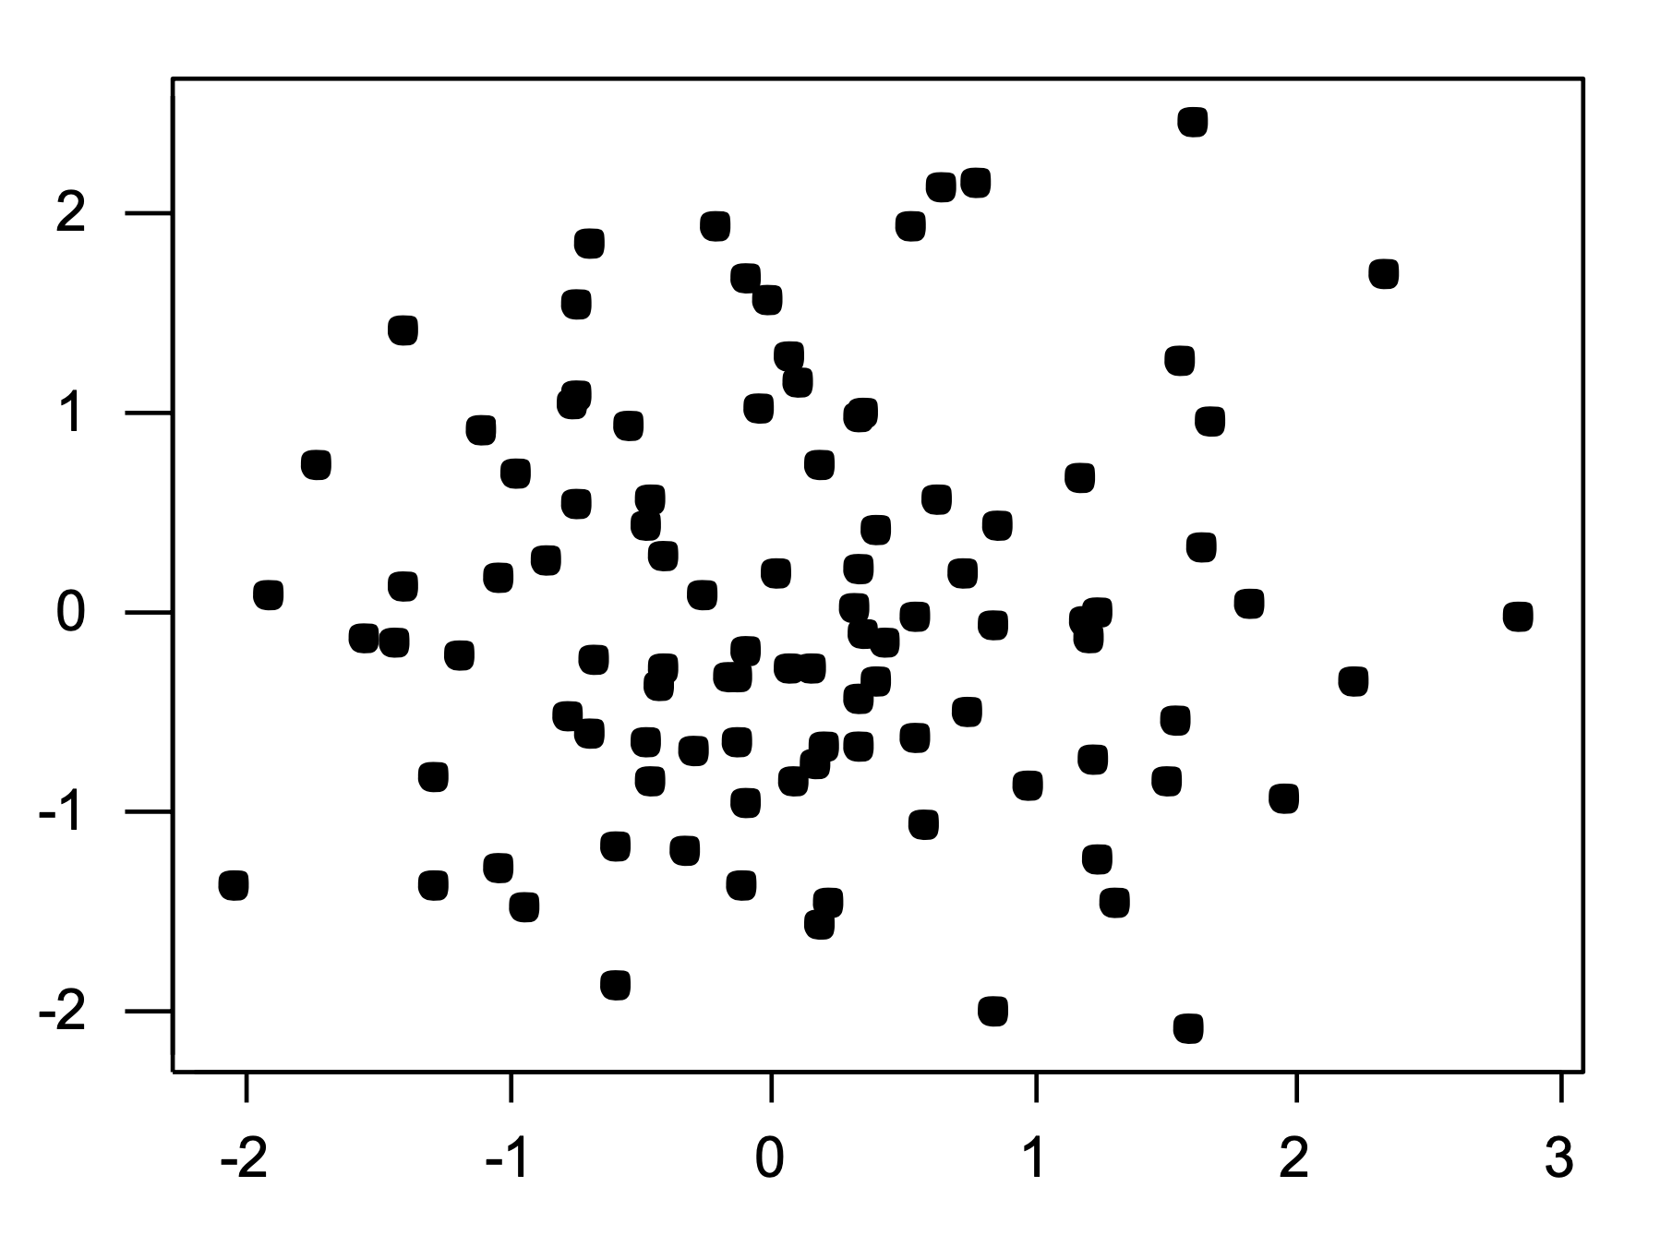
No correlation

Slide 58
The magnitude of correlation
Correlation:
B > A > C
A
B
C
B > A > C
A
B
C
The strength of linear relationship refers to how well a line depicts the relationship between X and Y. The larger the absolute value of the correlation, the stronger the linear relationship is.
Perfect linear relationship has the absolute value of r equal to 1.

Slide 59
Correlation strength and sign
A
B
C
Magnitude the strength of linear relationship (absolute value)
Sign the direction of the relationship (increase or decrease)
Correlation strength:
B> A > C
Correlation value (r):
A > C > B

Slide 60
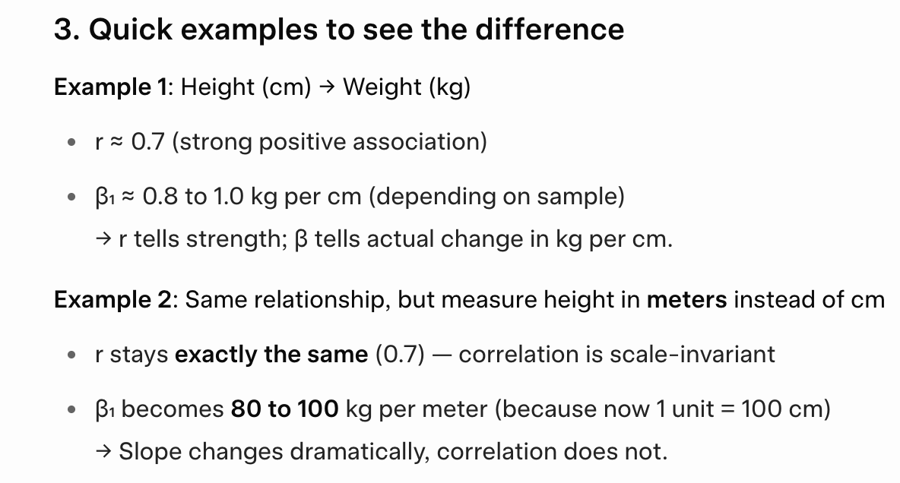
r vs. regression coefficient (beta)
Quick example to see the differences:

Slide 61
Notes about correlation
r has no units of measurement.
r does not change if you change the unit of measurement of variables (e.g., from lbs to kg). r is scale-free and symmetric.
r only measures the strength of the (assumed) linear relationship, it does not describe curved relationships.
r is not robust (no consideration of uncertainty and N).
Correlation does not directly imply causation.

Slide 62
Example
A 1971 study found that: people who drink a lot of coffee have a higher incidence of bladder cancer.
Correlation noticed. Causation?
1993: A larger study concluded that after adjusting for the effects of smoking, no evidence was found for increased risk from drinking coffee.
Correlation does not directly imply causation.

Slide 63
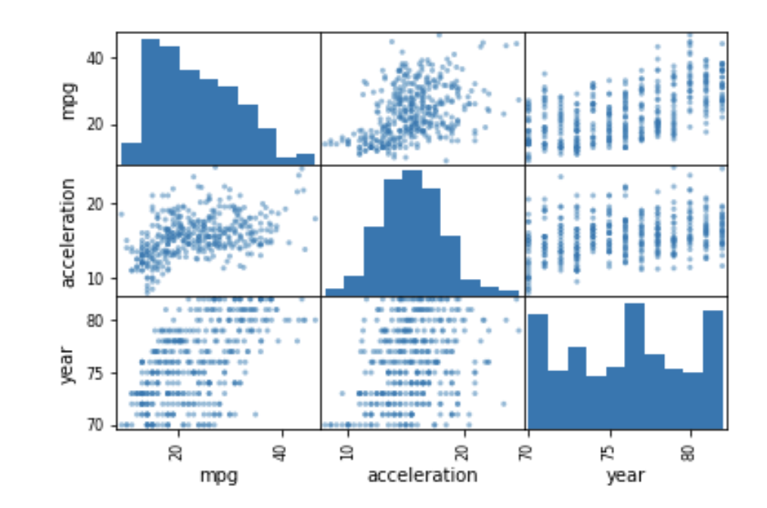
Multiple pairs of variables
Scatter plot matrix
Dataset: auto.csv

Slide 64
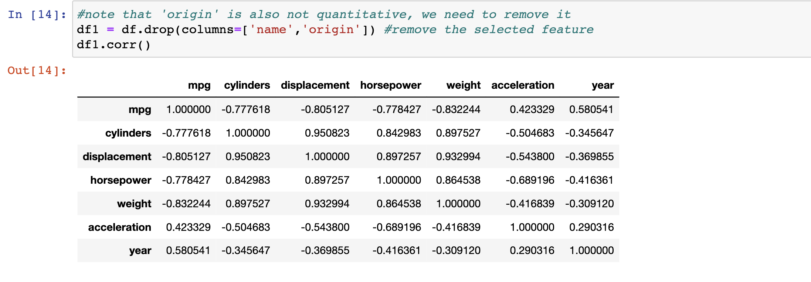
Multiple pairs of variables
Correlation matrix in Pandas
How to visualize these values?

Slide 65
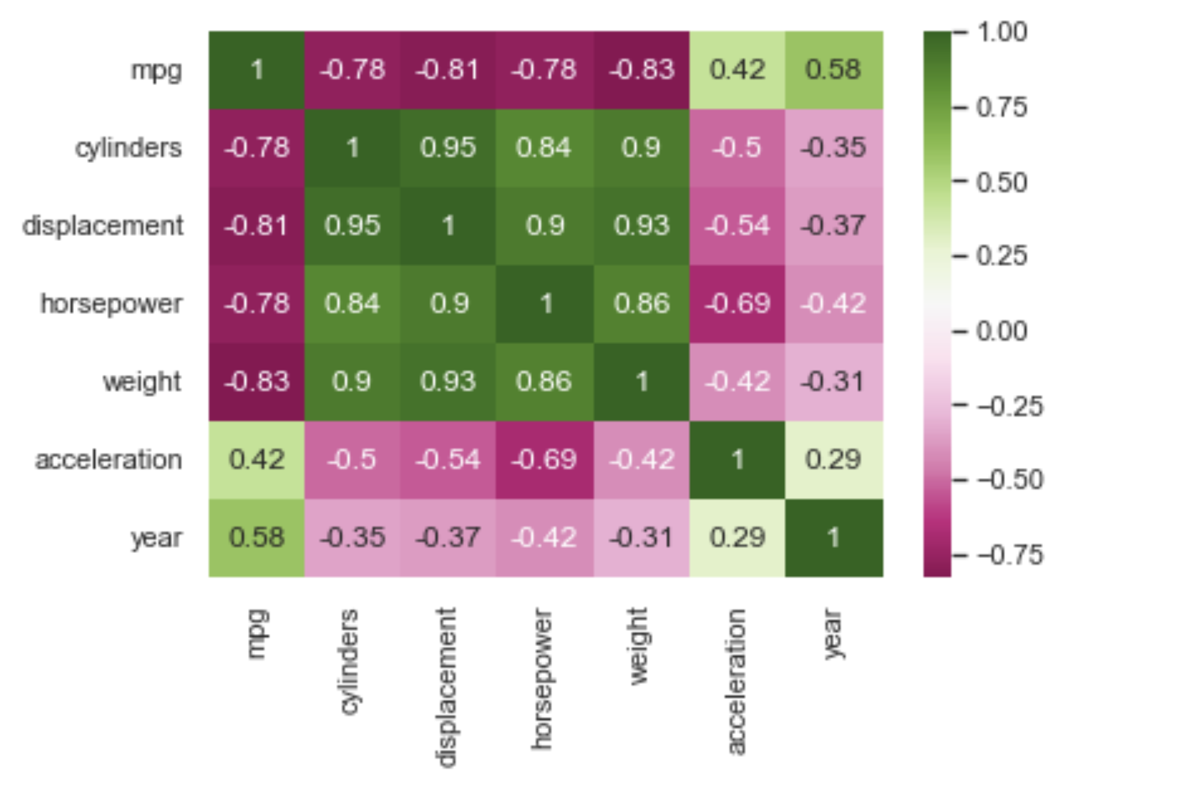
Multiple pairs of variables
Heatmap to show correlation matrix

Slide 66
Course notes
Find out group info on Canvas
Start the conversation early!
I will provide several topics as default choice
But, you can study any social science question
Tutorial time
EDA on the ICLR dataset
Examine variable distribution and relationships

